Slide 1


Slide 2
BRK162: Best practices and what’s new for managing Office 365 Groups
Mike McLean
Principal Program Manager
Microsoft
mmclean@microsoft.com
@mikemcleanlive | #BRK162

Slide 3
BRK162
Session information [hidden slide]
Populate your session information here
Best practices and what’s new for managing Office 365 GroupsSession Description
Office 365 Groups is the membership service that drives teamwork across Microsoft 365. In this session, we will share recent innovations across apps built on Office 365 Groups, including SharePoint Team Sites, Yammer, Outlook, Microsoft Teams, and more. We will perform a deep dive into Office 365 Groups governance and share best practices implemented at Microsoft. Learn how to easily manage Guest Access in the Office 365 Groups platform to collaborate with users inside and outside your organization. In addition, the Office 365 Groups product leadership team will provide insight into future roadmap items across the platform. Topics include: driving self-service, governance, groups expiry, naming policies, guest access, and supporting groups day-to-day at scale.
SharePoint Conference 2019 https://www.sharepointconference.com/#!/session/Best%20practices%20and%20what's%20new%20for%20managing%20Office%20365%20Groups/3861
Date: Wednesday, May 22, 2019 Time: 4:15 PM - 5:15 PM Room: Boulevard Ballroom 168
Speakers: Mike McLean

Slide 4
Key session takeaways
What’s new with Office 365 Groups?
How do I enable self-service with governance?
How do I extend collaboration with external guests?
What are best practices for managing groups at scale?

Slide 5

What’s new with Office 365 Groups?

Slide 6

2x
More collaboration
People work on twice as many teams and spend 50% more time collaborating
Teamwork
Internal, external & remote
People need to connect and communicate across organizations, locations & time zones.
The landscape has changed
Diverse workforce
People have different expectations, preferences, skillsets and abilities
Employee engagement
Globally, employee engagement is 15%, but at the best performing companies, 70% of employees are engaged and profits are 21% higher

Slide 7

Seamless experience for users
Connected, integrated applications streamline sharing and discovery, and simplifies adoption
Universal toolkit
Simplify IT Unified management, security and compliance makes deployment easier and reduces TCO
The most complete, integrated solution
Insights and analytics
Integration of people, content & activity enables AI & analytics to inform & accelerate decision making

Slide 8
Teamwork in Microsoft 365
Yammer
Teams
Outlook
Inner Loop
Outer Loop
People you work with regularly
People you connect with across the org
Content collaboration
Run effective meetings & projects
SharePoint
Inform & engage employees
Video & live events
Stream
Email
Ubiquitous for targeted communications
Manage your time & communications
Office 365 Groups

Slide 9
What is Office 365 Groups? Single identity for teamwork and beyond
Membership service for M365 teamwork apps
Teams, Outlook, Yammer, SharePoint, Planner, Stream, Forms, StaffHub, Dynamics CRM, Power BI
Office 365 Groups
Centrally managed and governed
Information protection, governance, and compliance
Extensible
Microsoft Graph, connectors, 3rd party app development
Notes:
- No staffhub, no yammer, graph need to investigate

Slide 10

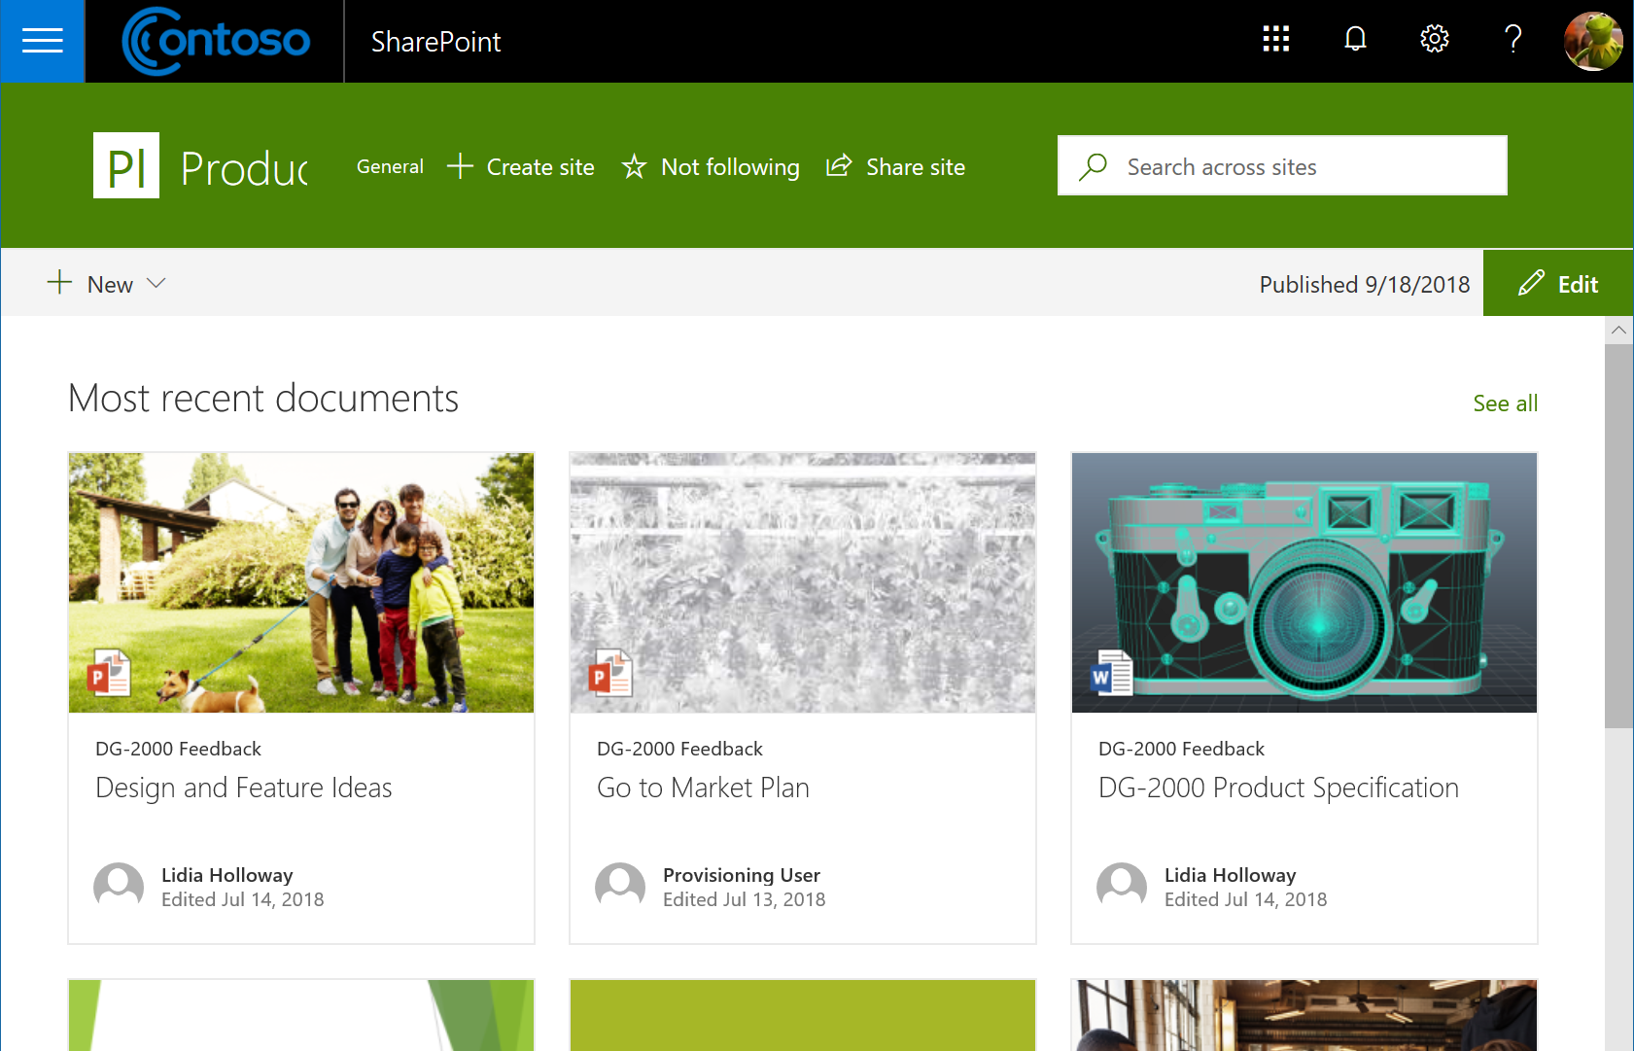

Groups Ecosystem Innovations
SharePoint: create group from existing site, hub sites, create Teams from SharePoint
Outlook: SharePoint files view on the web, my groups*, subscription settings, private-by-default
Microsoft Teams: hidden from Outlook, guests, dynamic membership support
Yammer: live events*, files in SharePoint*
Microsoft Stream: cloud recordings for meetings in Microsoft Teams*
Microsoft Planner: guests, SharePoint web part, schedule view, filters, copy plan
Microsoft Forms: integration to Office 365 Groups
Microsoft Project: Office 365 Groups integration to Project Roadmaps
* Preview or early release feature.

Slide 11
Office 365 Groups
What’s new with Office 365 Groups

Slide 12

How do I enable self-service with governance?
Notes:
Mike to speak

Slide 13
Empowering users with self-service
Enabled for all users
Everyone can create groups
Using teamwork apps to meet their diverse needs
Consistent classification and policy enforcement
Custom provisioning workflows
Limited to a subset of users
Creation is limited to certain business units/users
Progressively expand self-service during O365 apps onboarding
Guide users to collaboration choices
Common
Processes in place
Change management
Reporting & monitoring
Analytics

Slide 14
Managing and governing Office 365 Groups at scale
Creation permissions
Soft delete and restore
Policies and information protection
Upgrade DLs to groups in Outlook
Naming policy
Expiration policy
Reporting
Guest access

Slide 15
Group naming policy
Benefits
Applies to all apps
Ensure group names follow your organization schema
Use fixed strings or Active Directory attributes as prefixes and/or suffixes
Define custom blocked words
Guidance
Use short strings as suffix
Use attributes with values
Don’t be too creative, total name length has a maximum of 264 characters
Documentation: Office 365 Groups Naming Policy

Slide 16
Group expiration policy
Benefits
Expire groups older than a specific period
Group owners get email notification to take renewal action on the group
Can set expiration policy to specific groups
Expired groups can be restored within 30 days
Guidance
Pilot with specific groups initially
Choose inactive groups based on the activity report in Microsoft Admin center
Onboard your helpdesk team
Communicate renewal process to group owners
Ensure groups have multiple owners & configure email for ownerless groups
Documentation: Office 365 Group Expiration Policy | Configure Office 365 groups expiration

Slide 17
Group reporting
Benefits
Track total groups and inactive/active groups
Track both Exchange and SharePoint storage used
View group activity across group mailbox conversations, group site/files activity, etc.
Guidance
Monitor regularly to reach out to group owners of active groups to learn uses cases and amplify them internally
Leverage Power BI content packs for additional insights:
Office 365 Adoption content pack
Azure AD content pack
Microsoft Graph groups activity API
PowerShell cmdlet Office 365 Groups Report (Unified Groups)
Office 365 Reports in the admin center

Slide 18
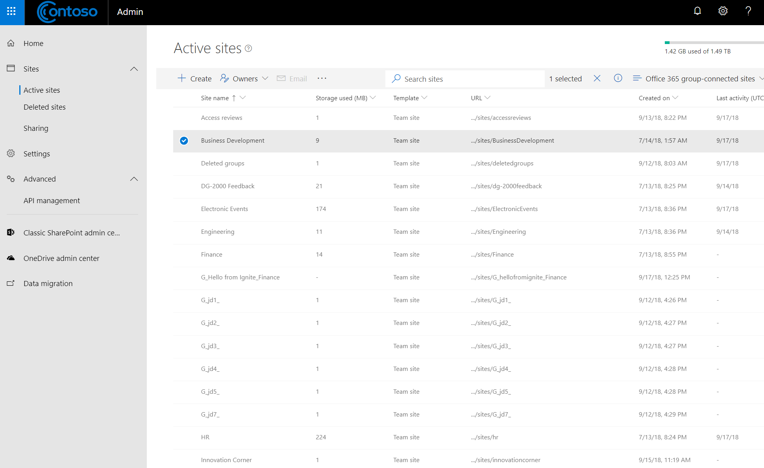
Groups administration innovations
Administration
Connect existing SharePoint sites to new O365 Groups
Microsoft 365 usage analytics in Power BI
Edit an Office 365 Group’s email/proxy addresses
Allowing a dot in the group alias when creating a group
New SharePoint admin center
Governance
Naming Policy generally available, AAD Portal UX (Preview)
Yammer, Outlook Mobile, and Outlook Desktop support for Office 365 Group naming policies
Microsoft Teams & Planner Azure B2B guest support
Other
Multi-Geo Groups support
Migrate your public folders to Office 365 Groups
New Power BI workspaces
Scalability & performance improvements

Slide 19
Office 365 Groups Self-Service
How do I enable self-service with governance?

Slide 20

How do I extend collaboration to external guests?
Notes:
Martina to speak

Slide 21
Groups guest access
Benefits
Enables safe teamwork outside the firewall
Works with any email addresses
Based on common Azure B2B platform
Guidance
Enable guest access!
Govern using:
allow/block guest domains
guest inviter role
terms of use
access reviews
Track guest user activity via audit logs
Documentation
Guest access in Office 365 groups
Guest access in Office 365 groups – Admin Help
Azure AD access reviews
Guest inviter role
Azure Active Directory Terms of Use feature
Google Federation

Slide 22




Best practices for Guest Access
User Permissions
“Guest Inviter” role
Domain Restrictions
Allow/deny list of external domains
Group Level
Enabled or disabled at the group level
Title = Manager
Guests
Member
Guests
Member
Guests
Using AD properties such as Title, etc
IT approved list of domains
Disable specific groups
Reach
Notes:
Admins can create a policy where only users with the “Guest Inviter” role can invite guests. This can be configured using Active Directory properties on the user object such as Title, Job Description, etc.
Admins can create an allow/deny list of external partner domains from which guests can be added.
Guest Access can be enabled or disabled at the group level.

Slide 23

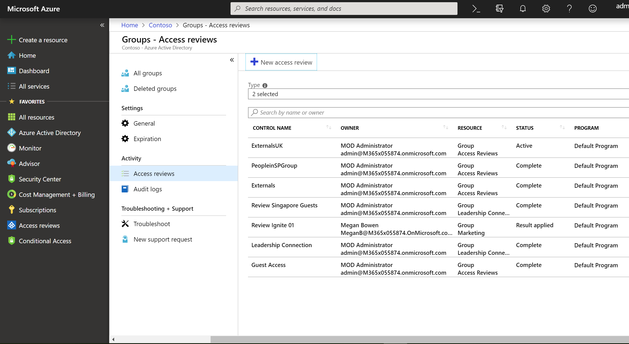
Guest access reviews
Define actions on your terms
Create policies per group
Actions are active immediately:
Guest is deleted from AAD
Guest sign-in is blocked

Slide 24
Guest Access
How do I extend collaboration to external guests?

Slide 25
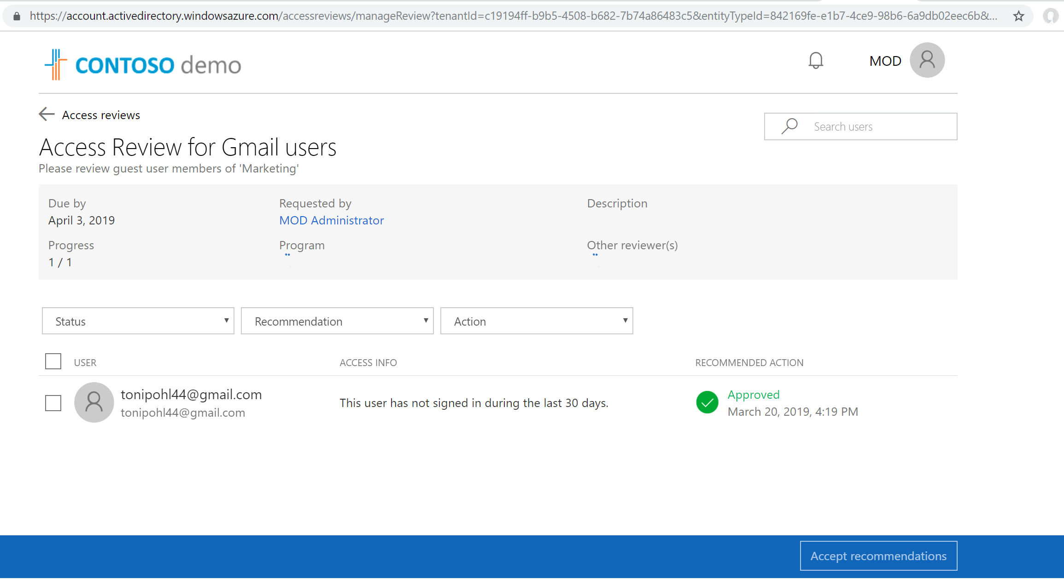

Slide 26
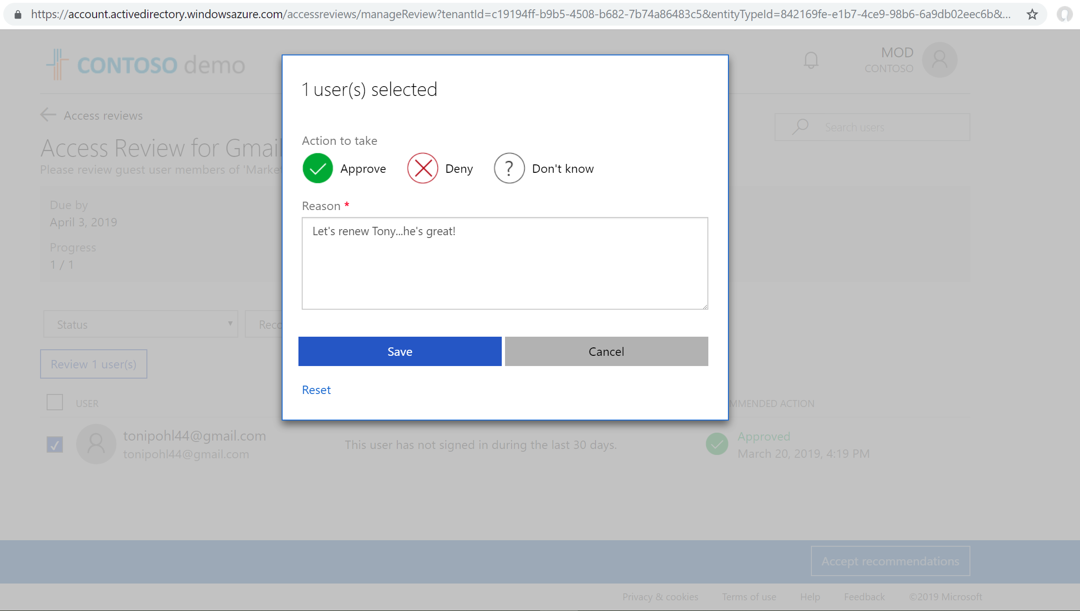

Slide 27

What are best practices for managing groups at scale?

Slide 28
Group policies & information protection
Benefits
Usage guidelines informs users about organization policies
Classification enables policy enforcement
Retention policies helps comply with industry regulations and internal policies
Labels helps you classify data across your organization
Guidance
Configure classification, usage guidelines, labels aligned with your org needs
Retention policies can be defined independently of labels
Audit groups activities: creation, deletion, etc.
Control group privacy and guest access based on classification
Documentation: Group settings | Overview of retention policies | Overview of labels | Search the audit log

Slide 29
Audit Ownerless Groups
#Get Ownerless groups
$OwnerlessGroups =[array](Get-UnifiedGroup | Where-Object {([array](Get-UnifiedGroupLinks -Identity $_.Id -LinkType Owners)).Count -eq 0})| Select Id, DisplayName, ManagedBy, WhenCreated, SMTPAddress
#Assign owner to the ownerless group
for($i=0; $i -lt $OwnerlessGroups.Count; $i++)
{
Add-UnifiedGroupLinks $ OwnerlessGroups.Alias -LinkType member -Links admin@contoso.com
Add-UnifiedGroupLinks $ OwnerlessGroups.Alias -LinkType Owner -Links admin@contoso.com
}
Identify the set of groups which do not have owners.
Add an admin as owner of the ownerless group
Add another user as the owner to ownerless groups.

Slide 30
Audit Groups Without Classification
#Retrieve all groups where classification is blank or null
$GroupsWithNoClassification = Get-UnifiedGroup | Where-Object {$_.Classification -Eq $Null -or $_.Classification -Eq ""} | Sort-Object DisplayName | Select DisplayName, Classification, ExternalDirectoryObjectId
#Set the classification of each group to “Medium"
ForEach ($G in $GroupsWithNoClassification) {
If ($G.Classification -Eq $Null -or $G.Classification -Eq "") {
Set-UnifiedGroup -Identity $G.DisplayName -Classification “High”
Write-Host “The group classification setting for" $G.DisplayName "was updated to medium.“
}
}
Identify the set of groups which don’t have classification assigned.
Update groups to assign a classification.
Configure additional group properties based on classification.

Slide 31
Audit Groups With Conflicting Properties
#Identify which groups have a mismatch of properties
$GroupsWithClassificationMismatch = Get-UnifiedGroup | Where-Object {$_.AccessType -eq ‘Public’ -and $_.Classification -eq “High”} | Select DisplayName, Classification, AccessType, ExternalDirectoryObjectId
#Set the Access Type to Private for all "High" groups
ForEach ($G in $ GroupsWithClassificationMismatch) {
Set-UnifiedGroup -Identity $G.DisplayName -AccessType ‘Private’
Write-Host “The following Group privacy setting was updated:” $G.DisplayName
}
Identify set of groups which have conflicting properties, such as a classification of “High” but Privacy of “Public”.
Update the set of groups to assign correct values.
Verify properties were updated successfully.

Slide 32
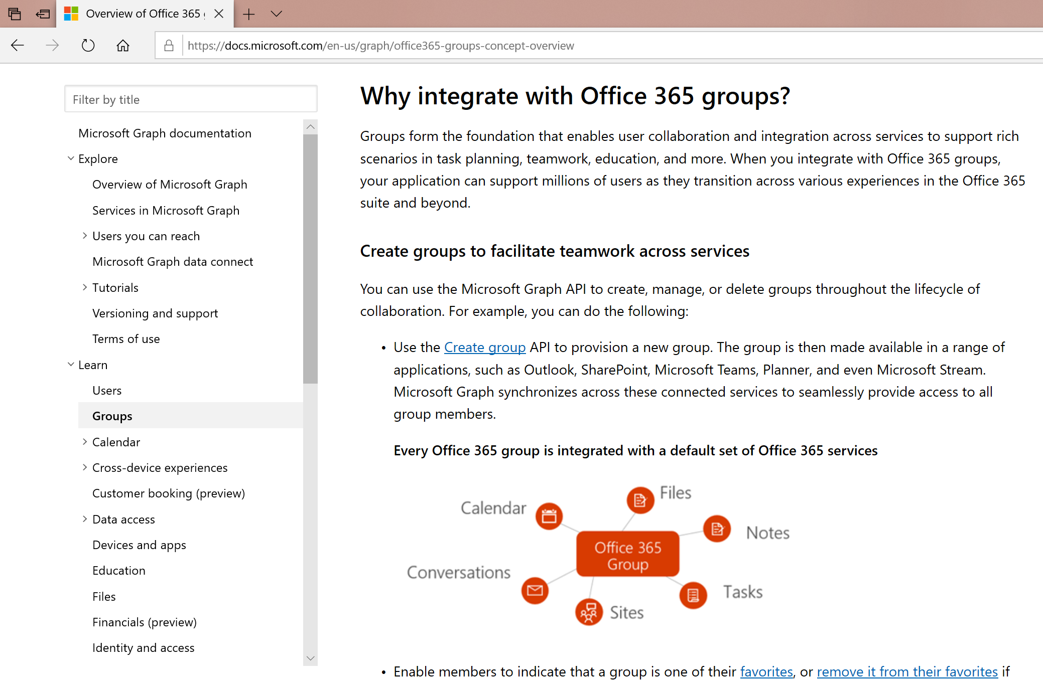
Office 365 Groups in Microsoft Graph
Microsoft Graph can help extend your business processes
Create custom workflows in SharePoint
Leverage Microsoft Flow to approve/deny requests

Slide 33
Managing Groups at Scale
What are best practices for managing groups at scale?

Slide 34
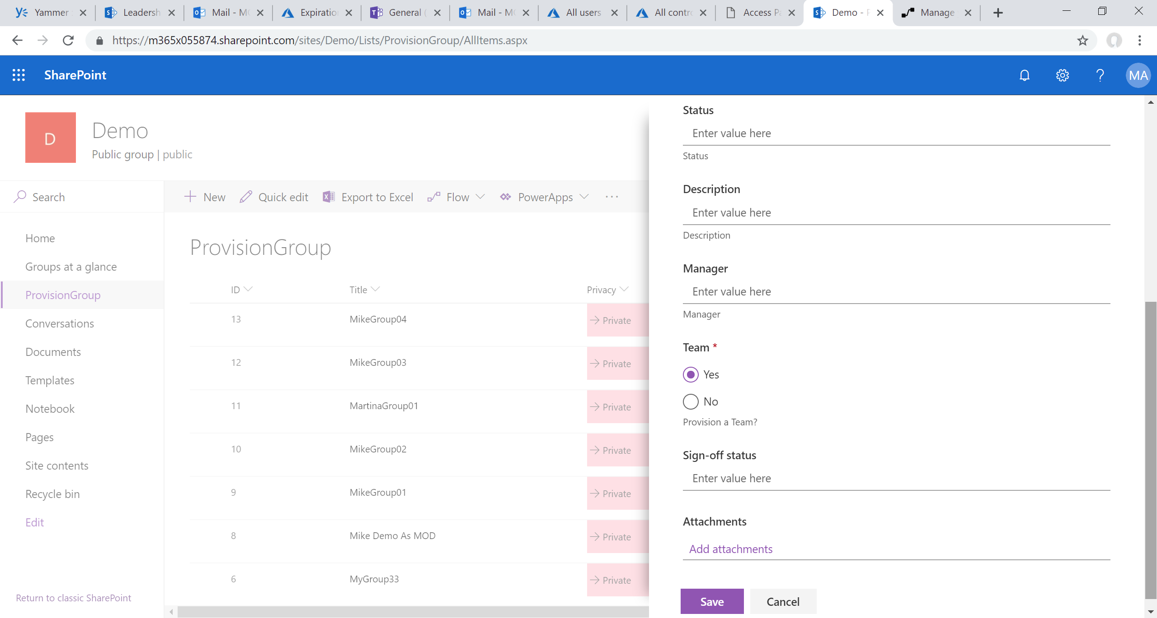

Slide 35
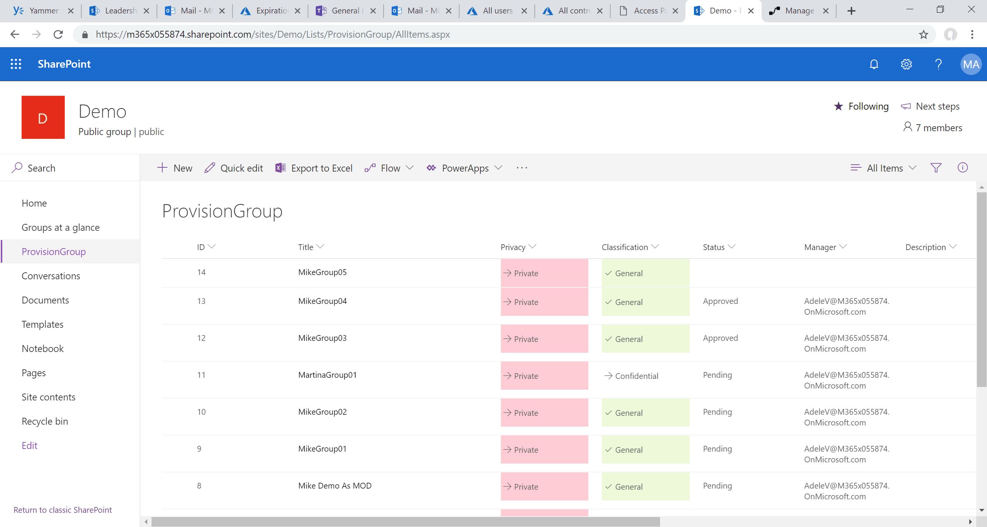

Slide 37
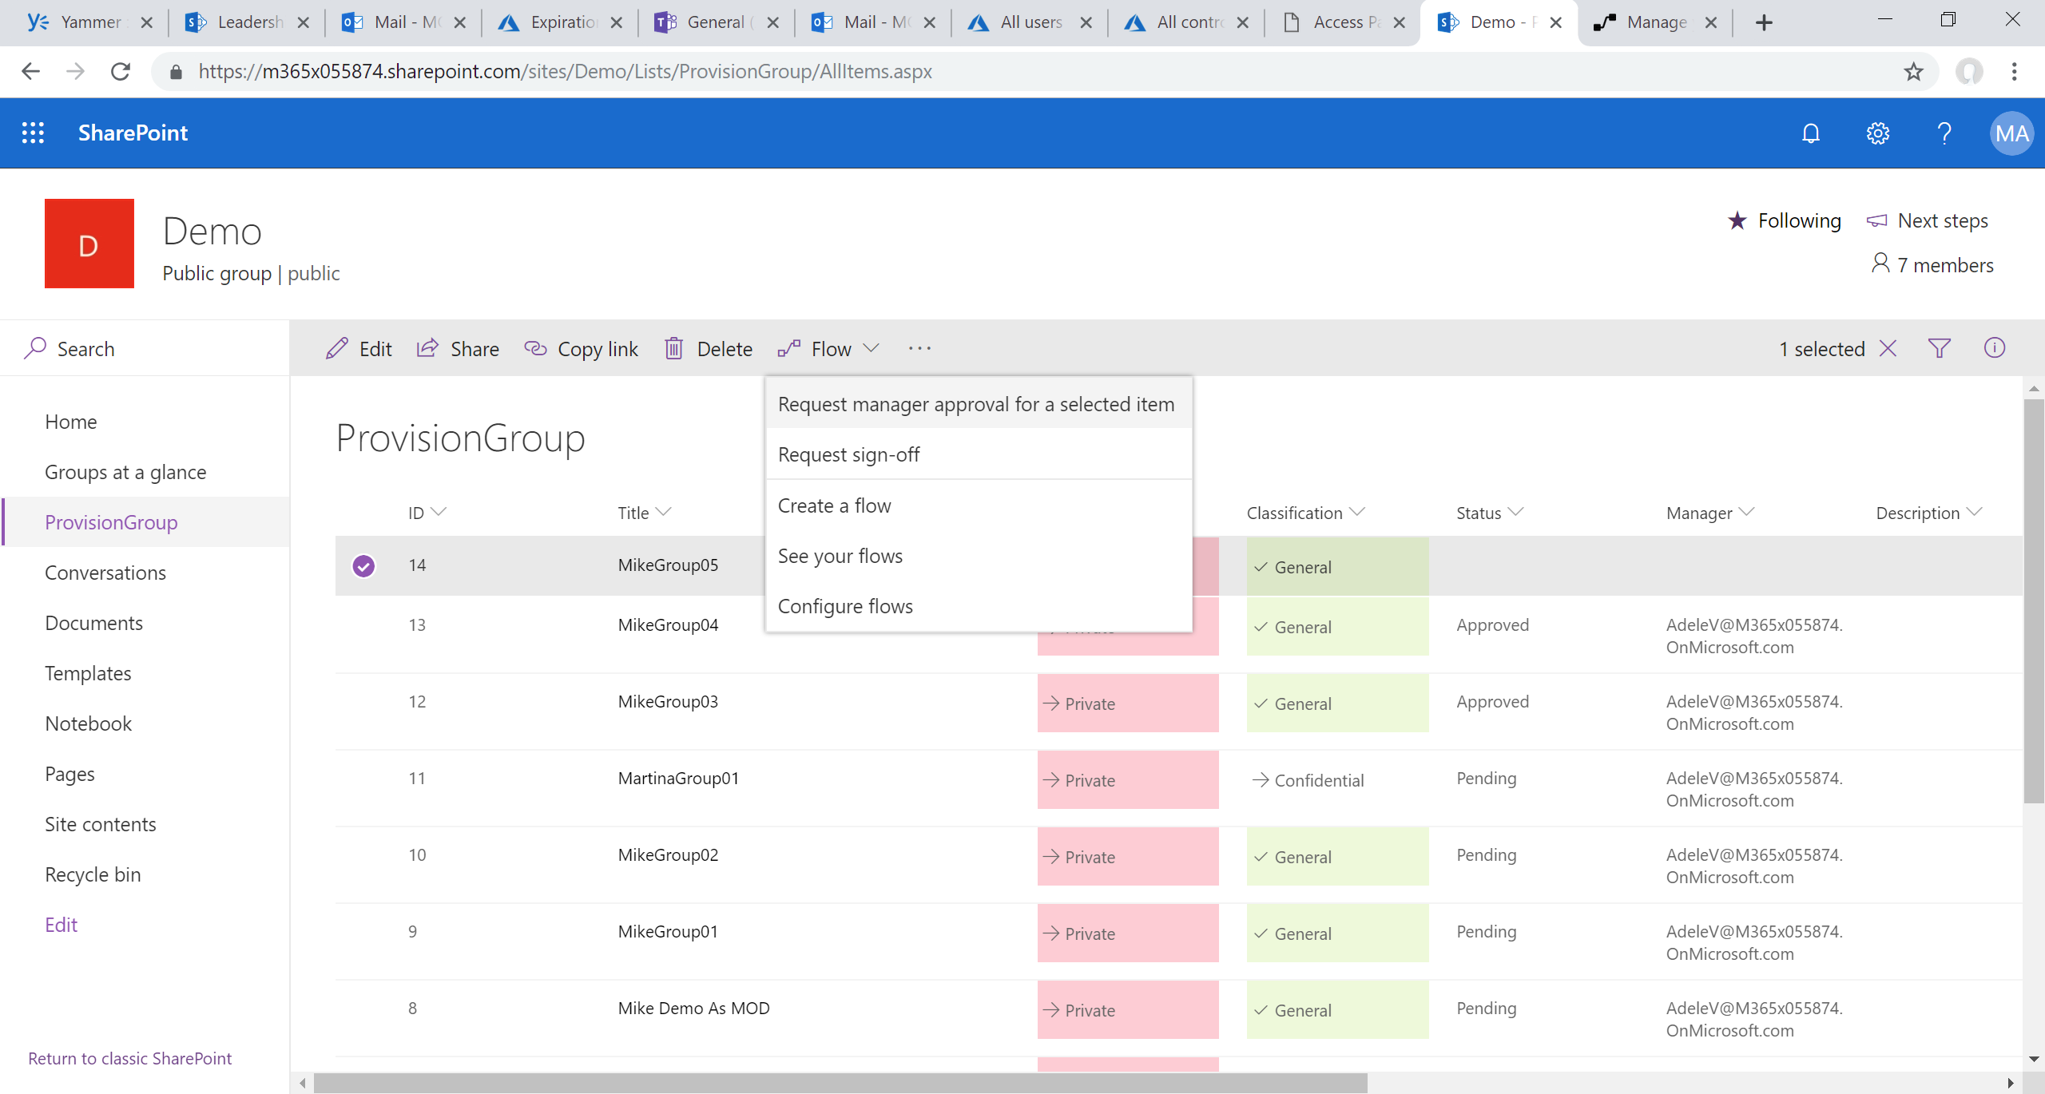

Slide 38
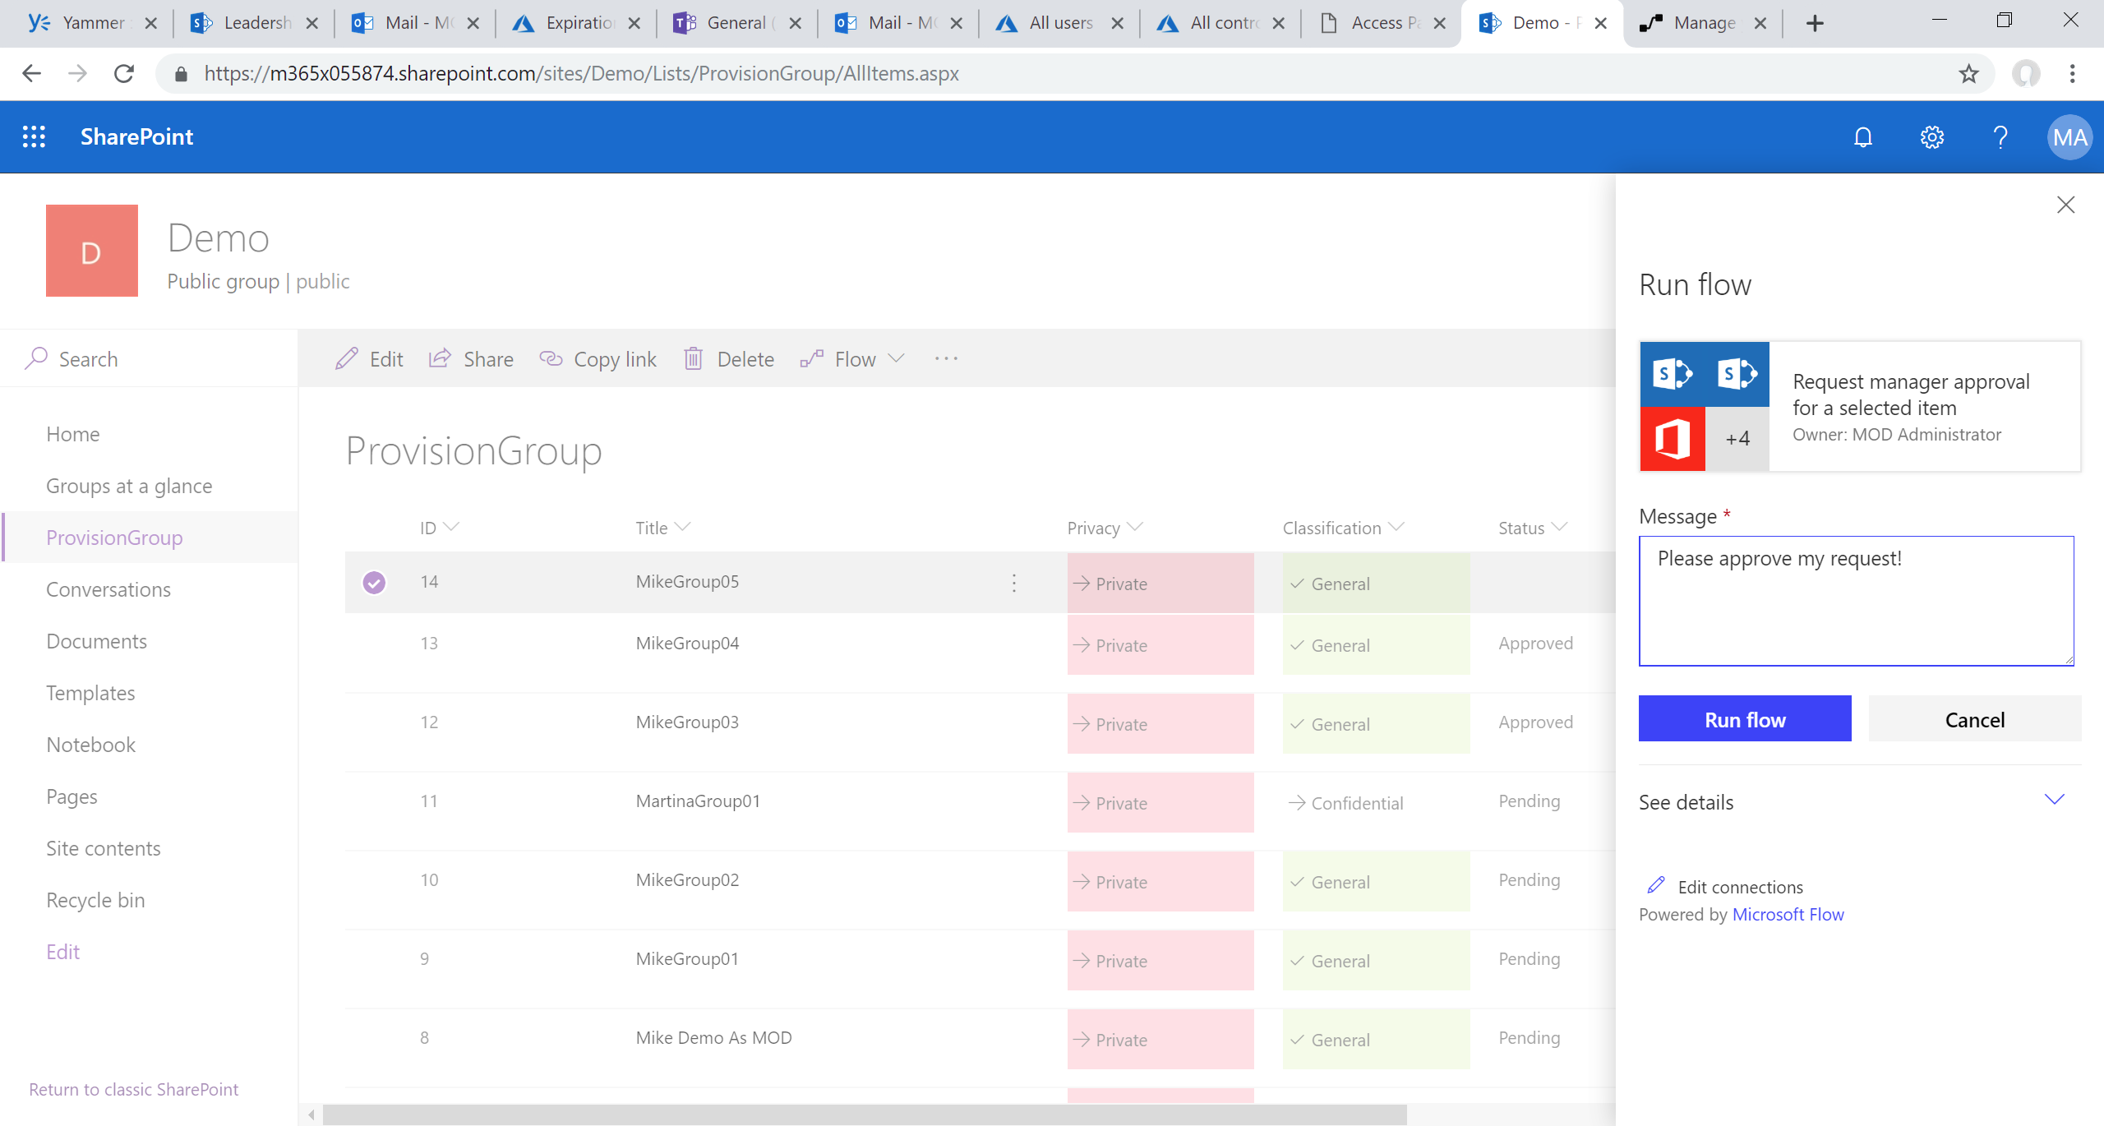

Slide 39
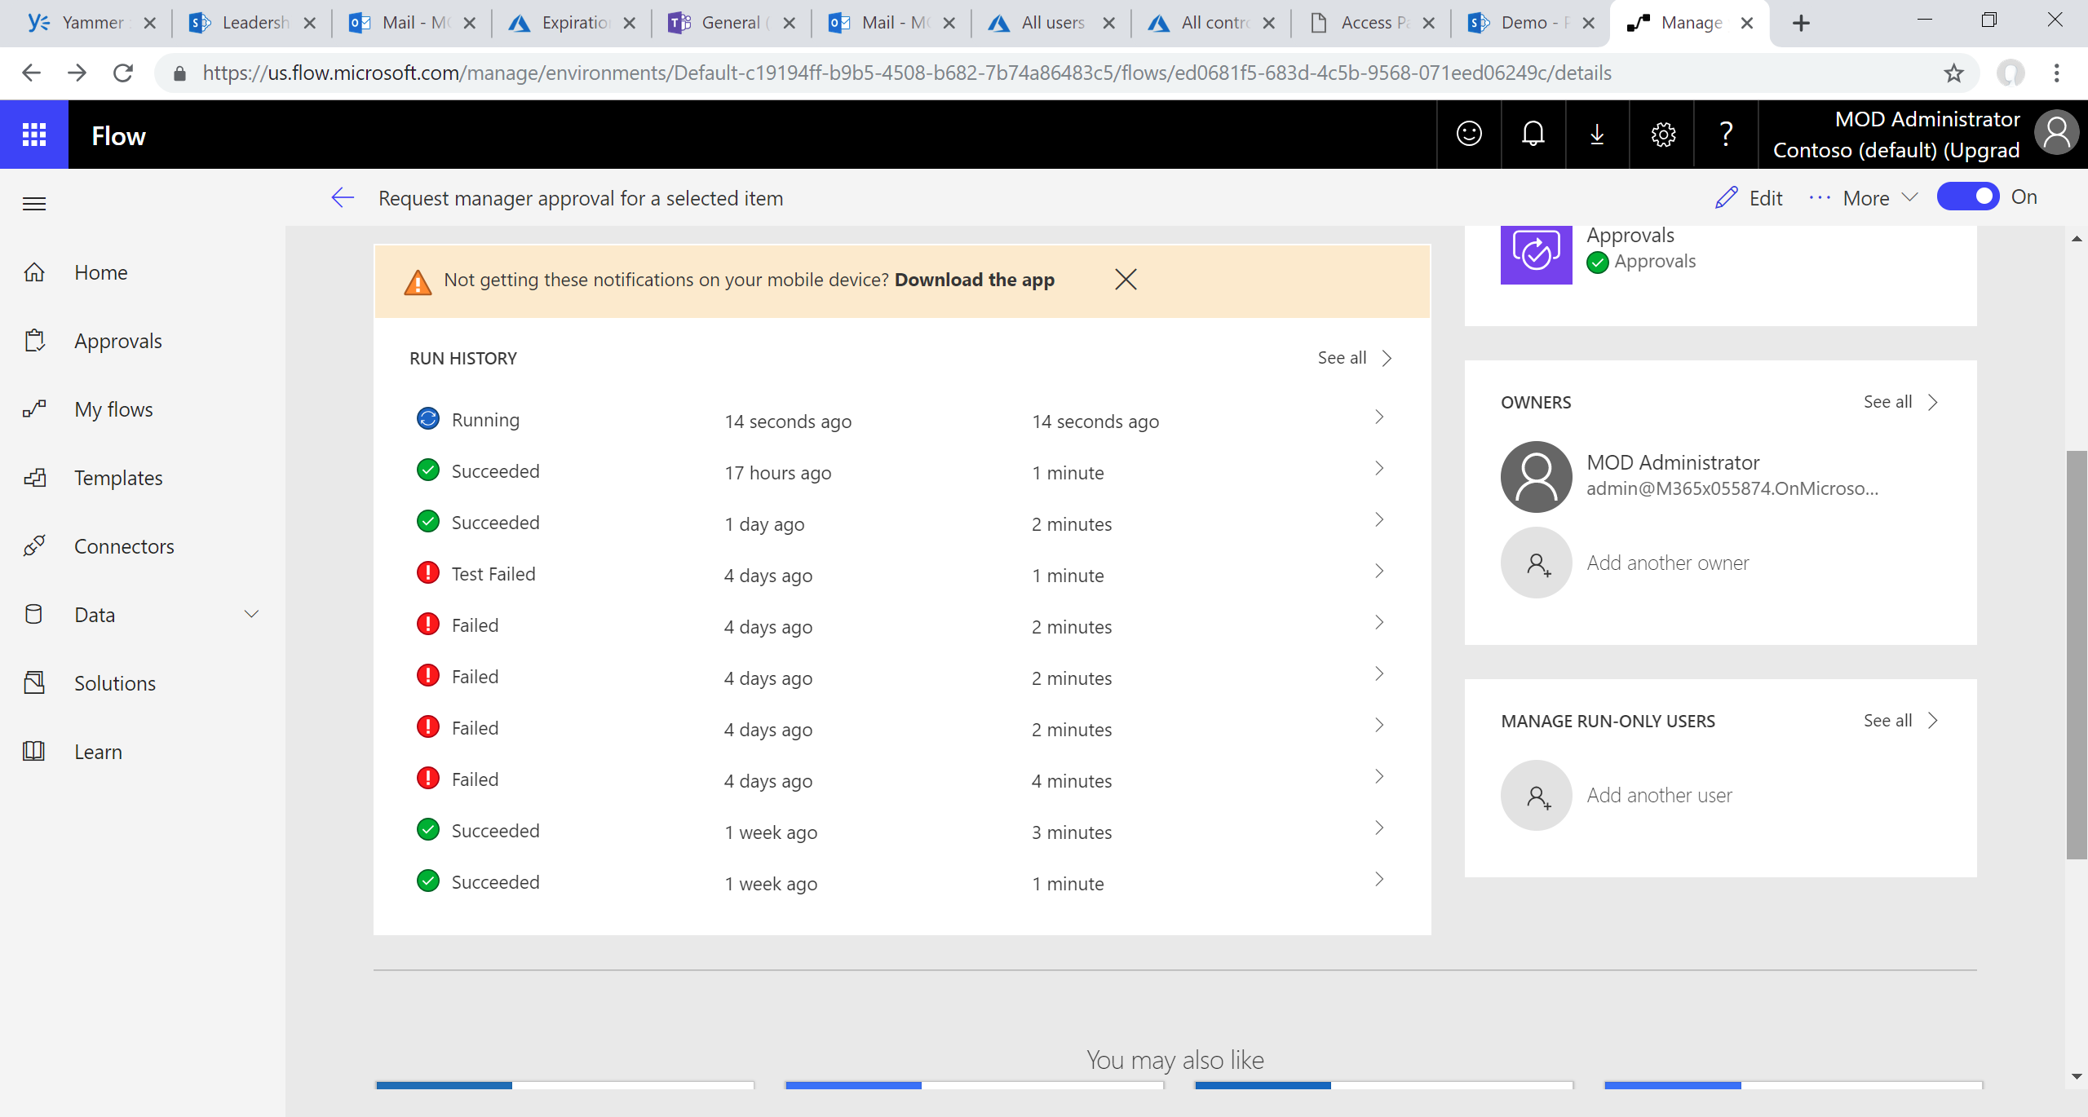

Slide 40
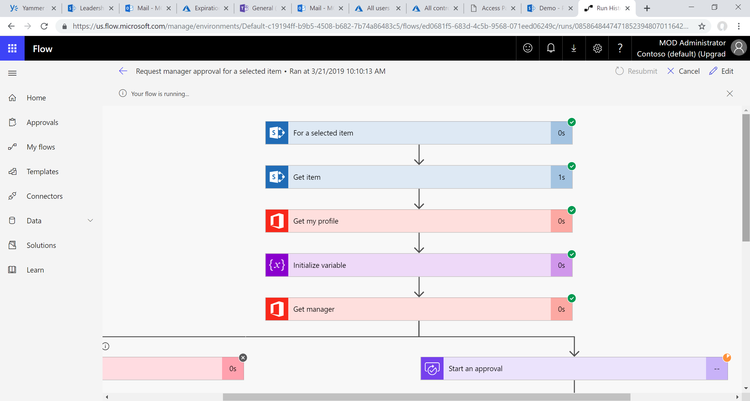

Slide 41
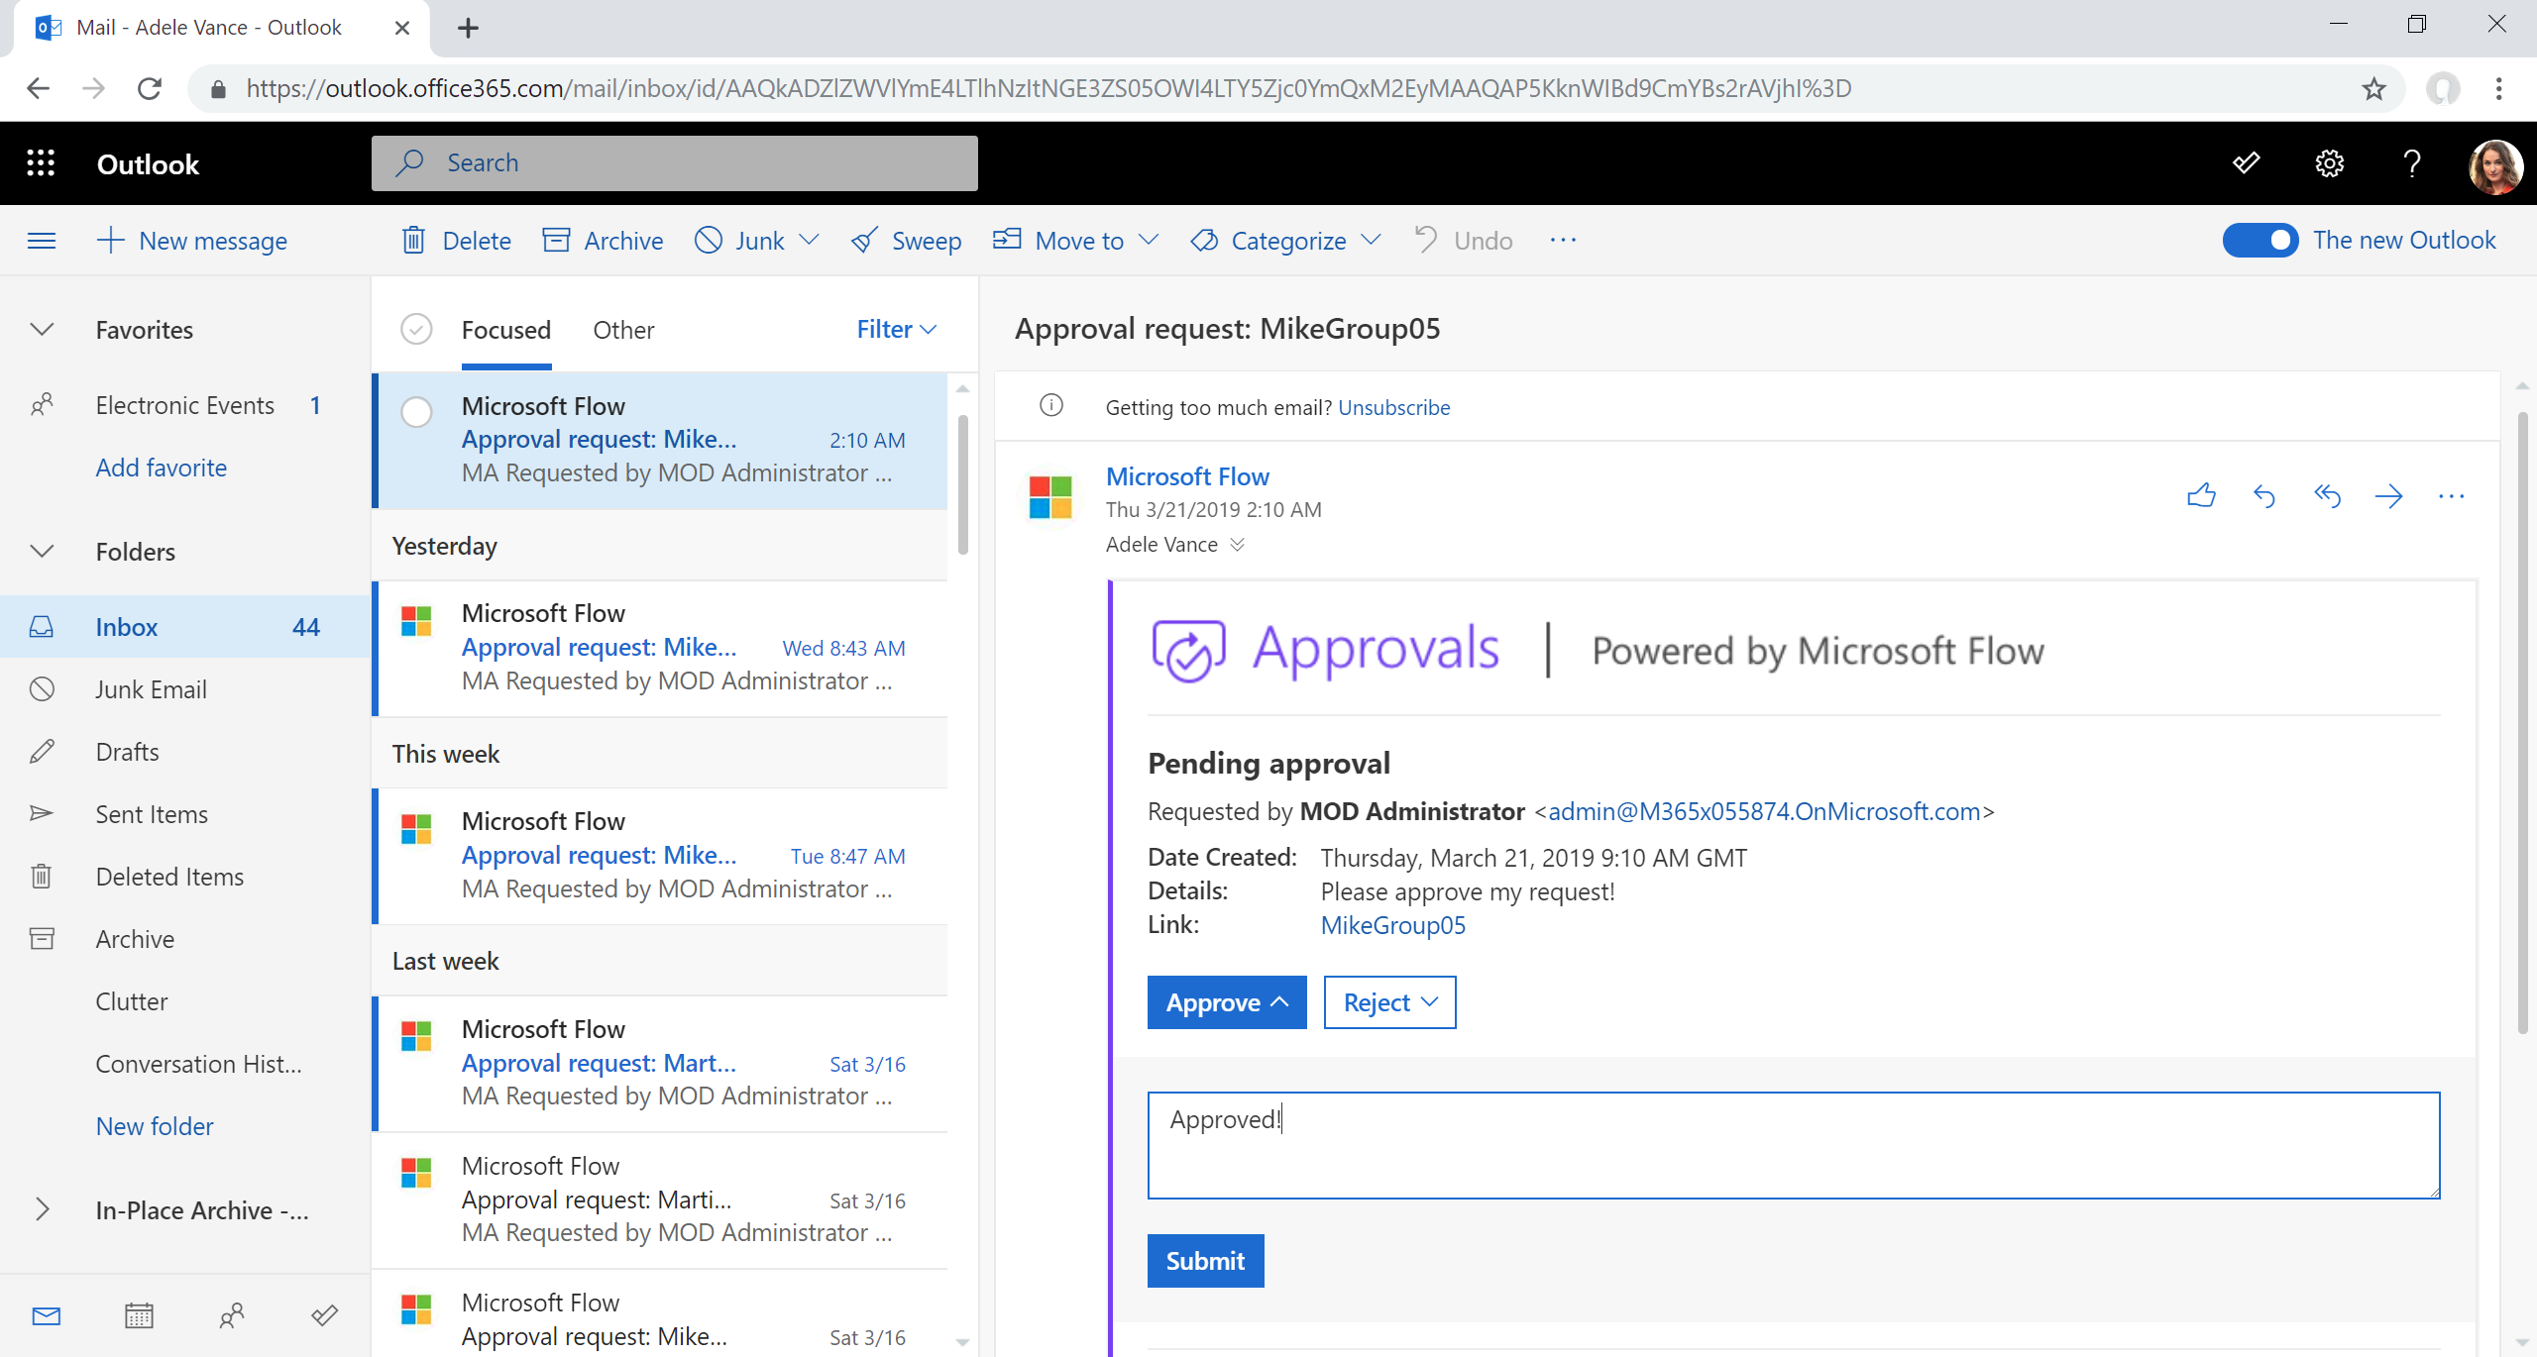

Slide 42
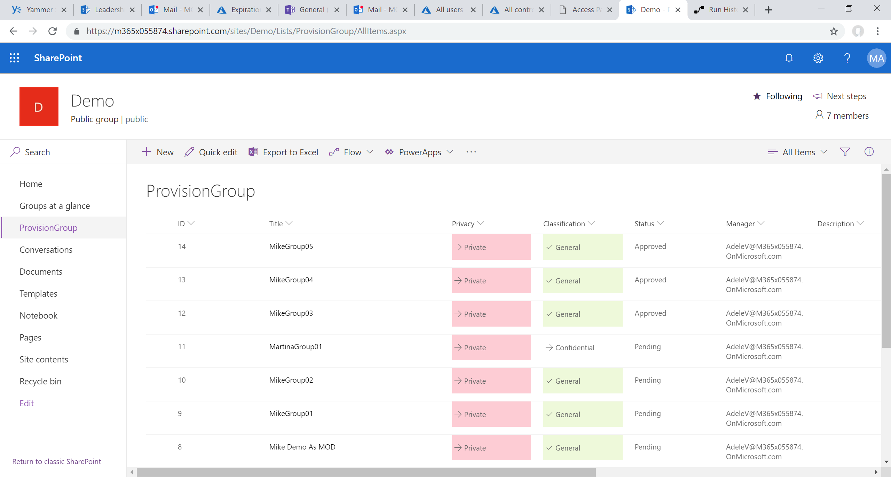

Slide 43
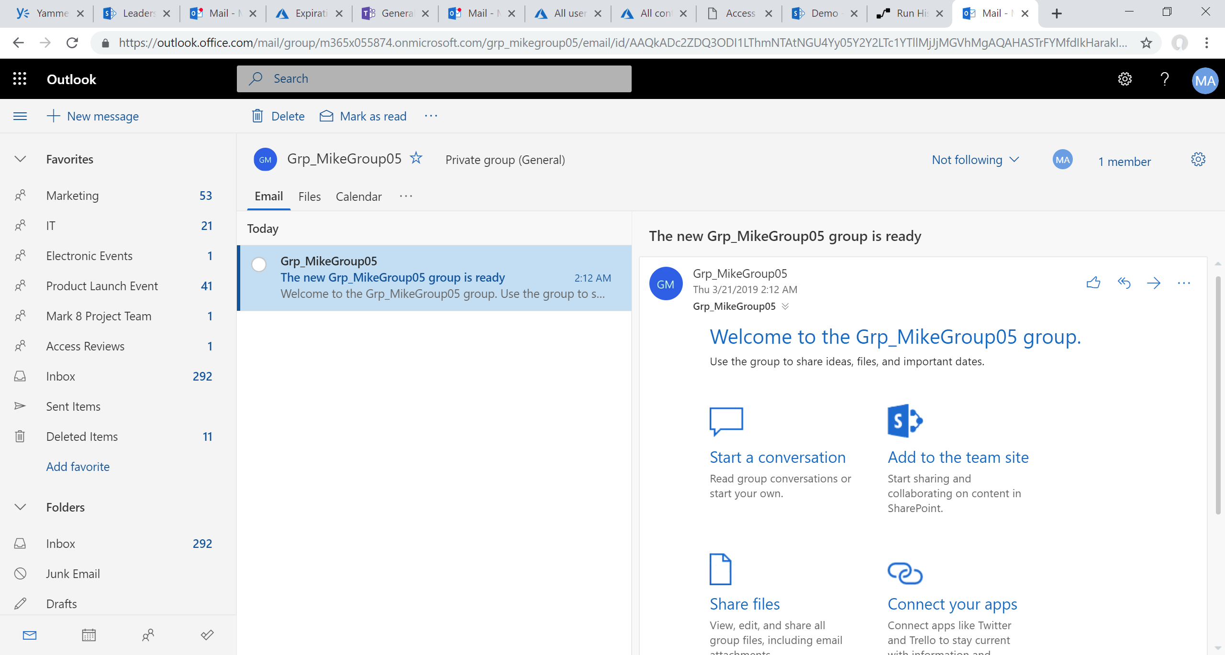

Slide 44
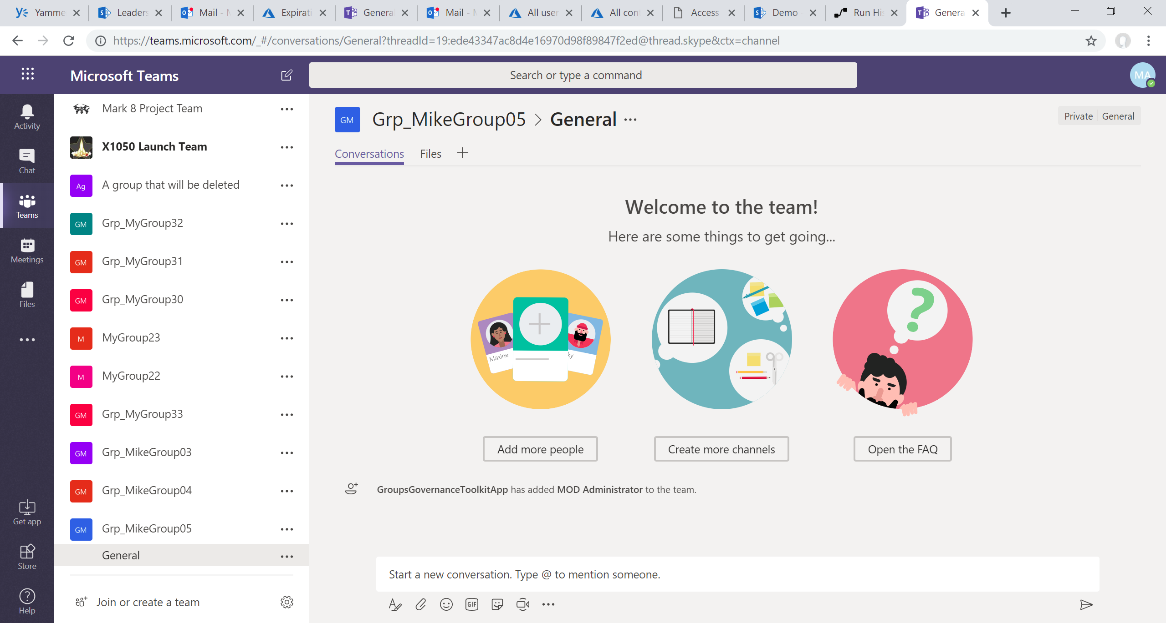

Slide 45
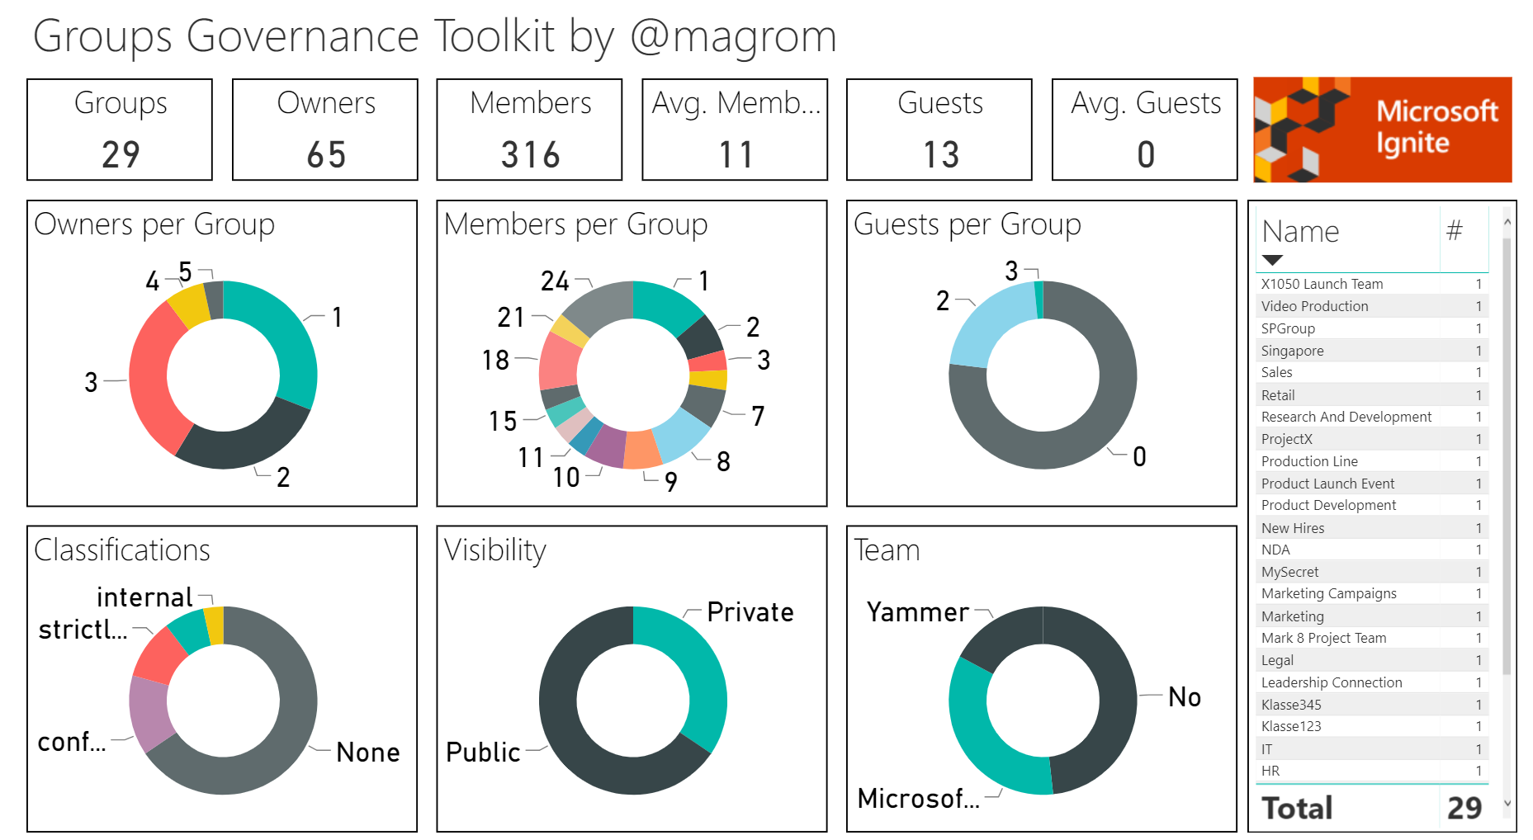
Groups Governance Toolkit
Documentation: Blog | GitHub

Slide 46
How does Microsoft IT manage groups? Empower employees while protecting content, keeping compliant and holding employees accountable
Self-service group creation and lifecycle
Creation tied to Dynamic Group of all full-time employees; non-employees can’t create groups
No naming prefix/suffix but blocked words
180-day group life-cycle; groups must be renewed or will be deleted (unless under retention) (expiry policy)
Usage guidelines shown with plain language; e.g. “Be polite & inclusive”
Custom job emails group members for groups with no owner
Classification, protection & compliance
Classification configured in Azure AD; Highly Confidential, Confidential (default), General
Custom jobs set Privacy to Private and disable external membership/sharing based on classification
Group site provisioned in region tied to user’s Preferred Data Location (multi-geo)
Membership reviews for groups with external members (access reviews)
Divisional groups created in SharePoint have retention configured with site template
Custom jobs to enforce ownership policy (2 owners with at least 1 full time employee)
A foundation for modern collaboration: Microsoft 365 bolsters teamwork
Notes:
Mike to speak

Slide 47
Office 365 Groups roadmap
Expiry auto-renewal based on activity and in-app expiry notifications
Groups admin role
Guest access with one-time passcode
Group driven membership
Unified Group classification using Microsoft Information Protection Labels
Group Card member search
Group calendar invites owned by group with select invitees
Admin center improvements
Remove admin license restriction for Exchange properties
Outlook actionable messages, Drag and Drop to Group folders

Slide 48
Key session takeaways
What’s new with Office 365 Groups?
How do I enable self-service with governance?
How do I extend collaboration with external guests?
What are best practices for managing groups at scale?

Slide 49

Next steps
Create a plan to enable self-service with governance
Key resources
Documentation | aka.ms/O365g
Questions | aka.ms/O365ng
User voice | aka.ms/O365uv
FastTrack | fasttrack.microsoft.com/office
Microsoft Graph | aka.ms/O365GGraph
Roadmap | office.com/roadmap
Governance Toolkit | github.com/martinagrom
Thank you!
Mike McLean
Microsoft
@mikemcleanlive | #BRK162

Slide 50

Thank you

Slide 51
Thank you
Resources
Try to stick as closely as possible to this list of resources, but delete or modify rows where necessary.
If you have a lot of resources, create a resource page and point to it with aka.ms/SPC19/Sessions/<Session Code>.
PMMs own getting the resources online with AKAs.
Questions
Create a plan to enable O365 Groups self-service with governance | | Drive teamwork with FastTrack resources
aka.ms/O365g | Documentation
aka.ms/O365ng | Questions
aka.ms/O365uv | O365 Groups User Voice
fasttrack.microsoft.com/office | FastTrack Deployments
aka.ms/O365GGraph | Microsoft Graph
office.com/roadmap | Roadmap
github.com/martinagrom | Governance Toolkit
Mike McLean
Microsoft
@mikemcleanlive

